Slide 1
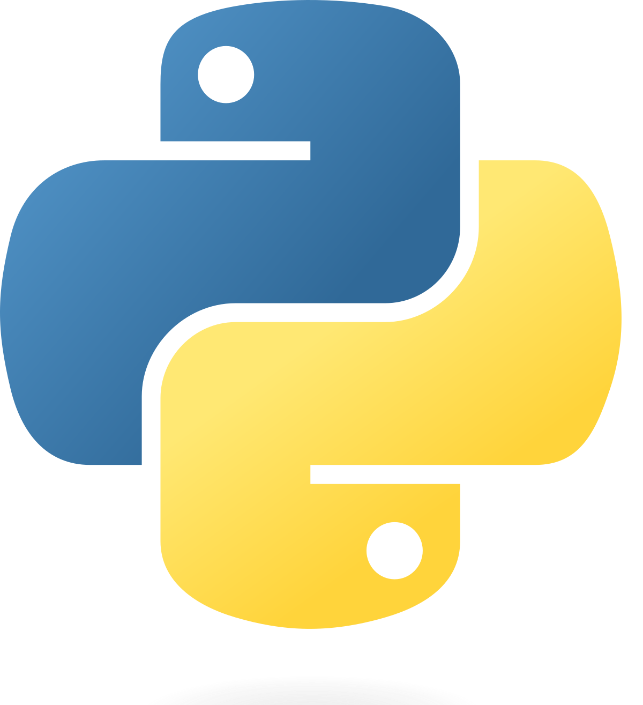
PYTHON
Matevž Berginc, R3.B

Slide 2
TABLE OF CONTENTS
What Is Python
Python History
Python Usage
Why Is Python Popular
Python VS C#
Practical part
Conclusion

Slide 3
WHAT IS PYTHON
Programming language
General purpose
High-level

Slide 4
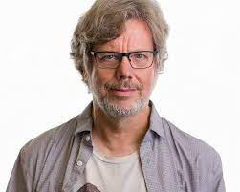
HISTORY OF PYTHON
Guido Van Rossum
February 20th 1991
12th July 2018
2019 Steering Council

Slide 5
PYTHON USAGE
Development
Task automation
Machine learning
Analysis
Everyday tasks

Slide 6
WHY IS PYTHON SO POPULAR
Versatile
Simple syntax
Beginner friendly
Open source
Large community

Slide 7
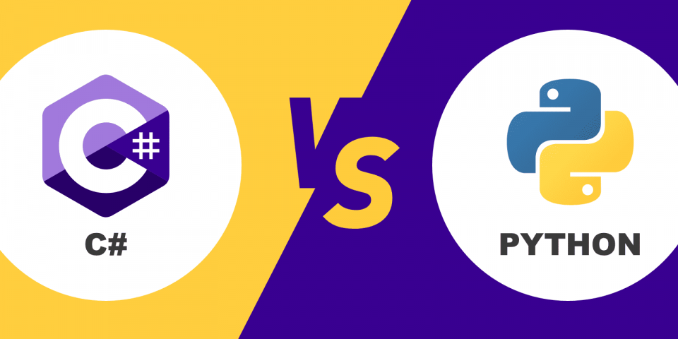
PYTHON VS C#
Similar
Microsoft/Free distribution
Library
Adaption
Limitations
Performance

Slide 8
PRACTICAL PART

Slide 9
CONCLUSION

